Slide 1
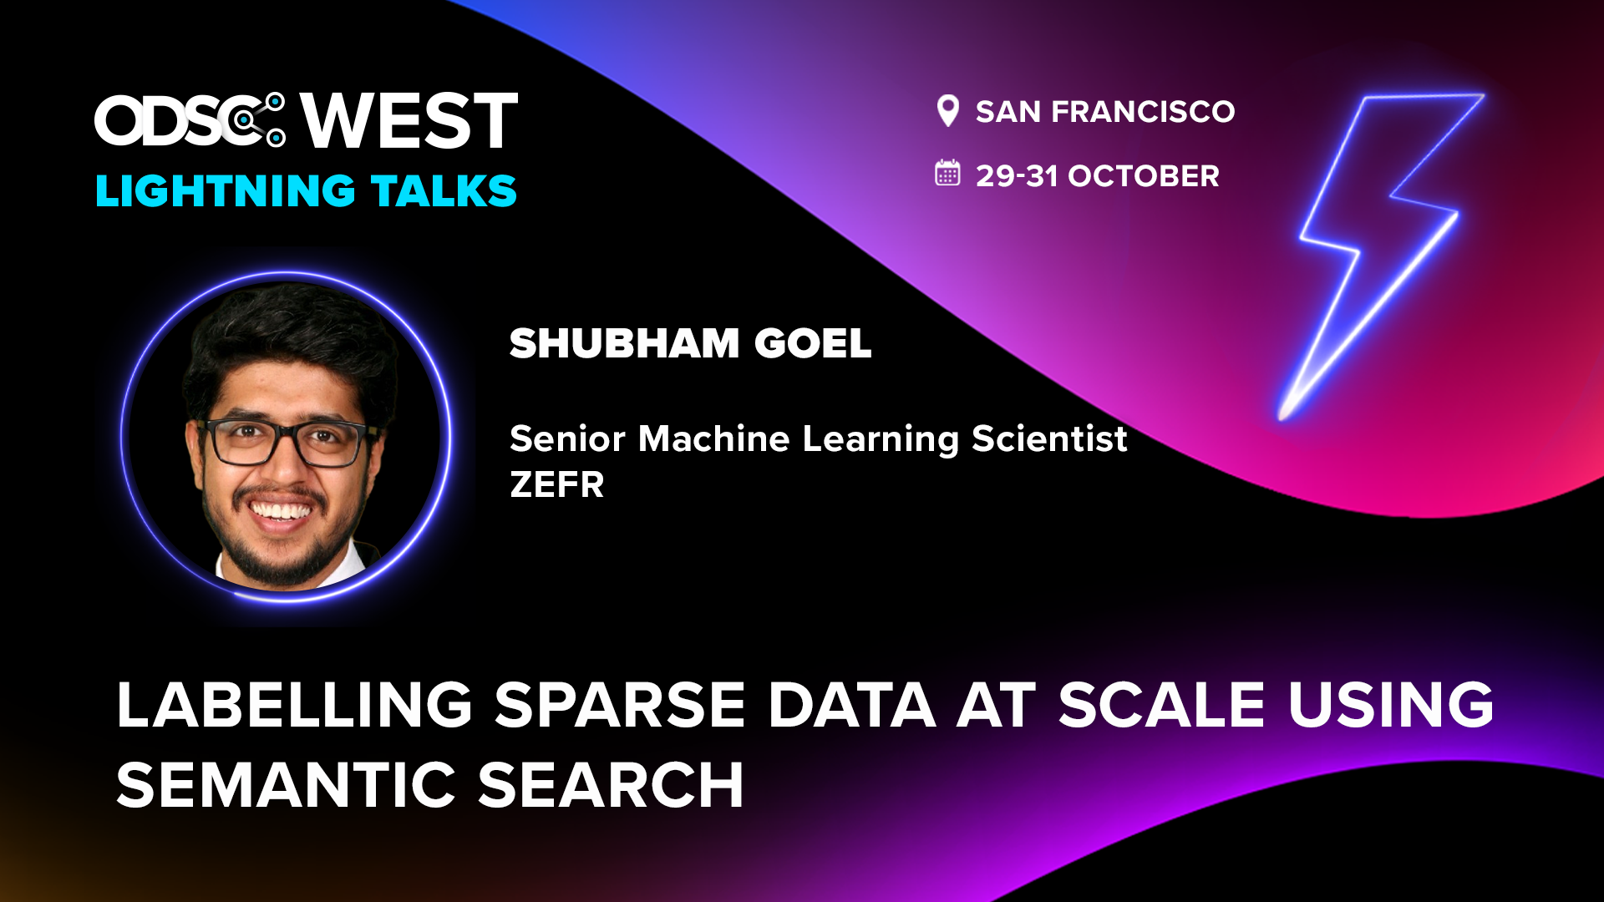
Labelling Sparse Data at Scale using Semantic Search
Shubham Goel

Slide 2
Problem
Brand Safety across platforms - YouTube, TikTok, Meta, Snap
Brands such as Adidas, Disney, etc. looking to advertise on these platforms come to us to ensure Brand Suitability and Safety across several risk categories
Profanity
Hate speech
Adult
Drugs, Alcohol and Tobacco
Graphic
etc.
Need robust models to classify content using multiple features -
Caption
Hashtags
Video
Audio transcript
User/Content metadata such as likes, impressions, user handle, etc.
“81% of respondents would stop purchasing a product they regularly buy if they discovered the brand’s ads had appear next to racist content or hate speech”
Notes:
two people dressed up in deadpool cosplay suits fighting with swords

Slide 3

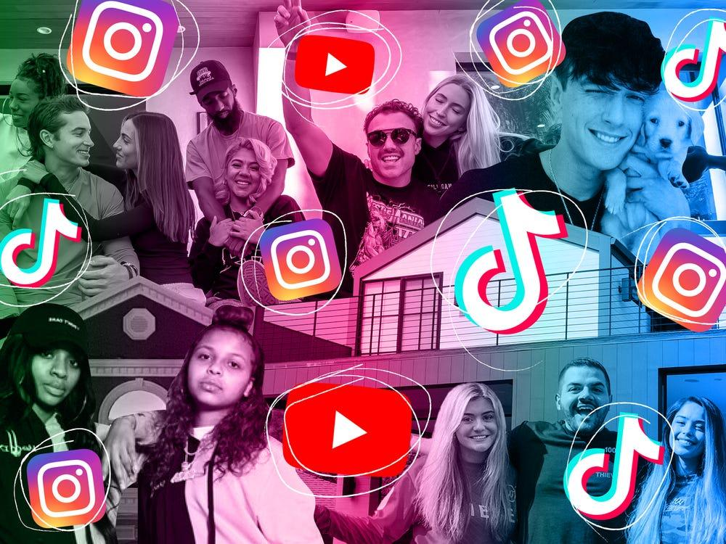
Data, Data, Everywhere!
Replace Image Here

Slide 4

Visual depiction of me trying to find anything in that data

Slide 5
What if you’re looking for a video which has
a guy holding a beer can
someone talking about doing drugs
people texting about sexually explicit content
missiles being fired in the background
two people dressed up in deadpool cosplay suits fighting with swords
…(let your imagination run wild)
Notes:
two people dressed up in deadpool cosplay suits fighting with swords

Slide 6
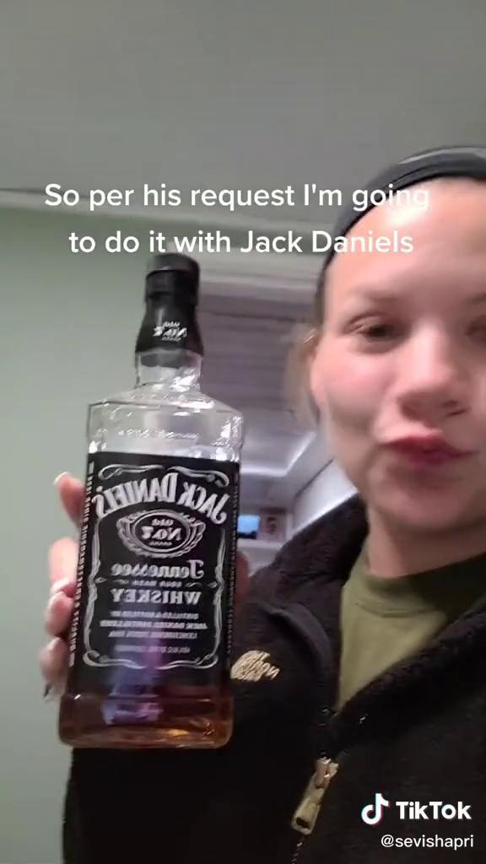
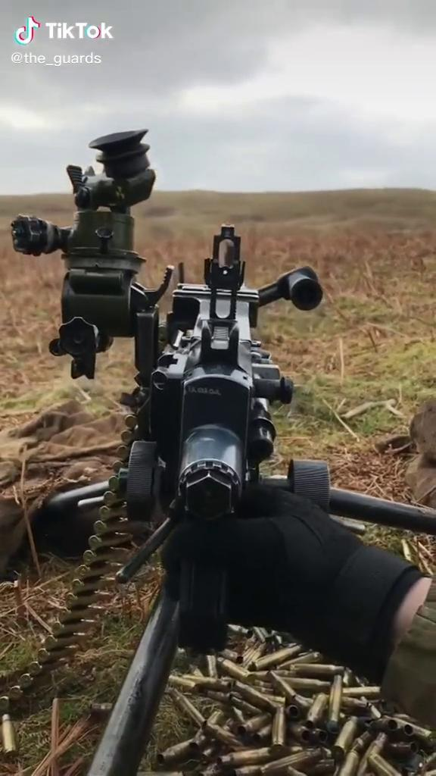

Or maybe a video similar to

Slide 7

Semantic Search be like
Notes:
It’s likely that many of you have already seen this
But let me bore you one more time

Slide 8
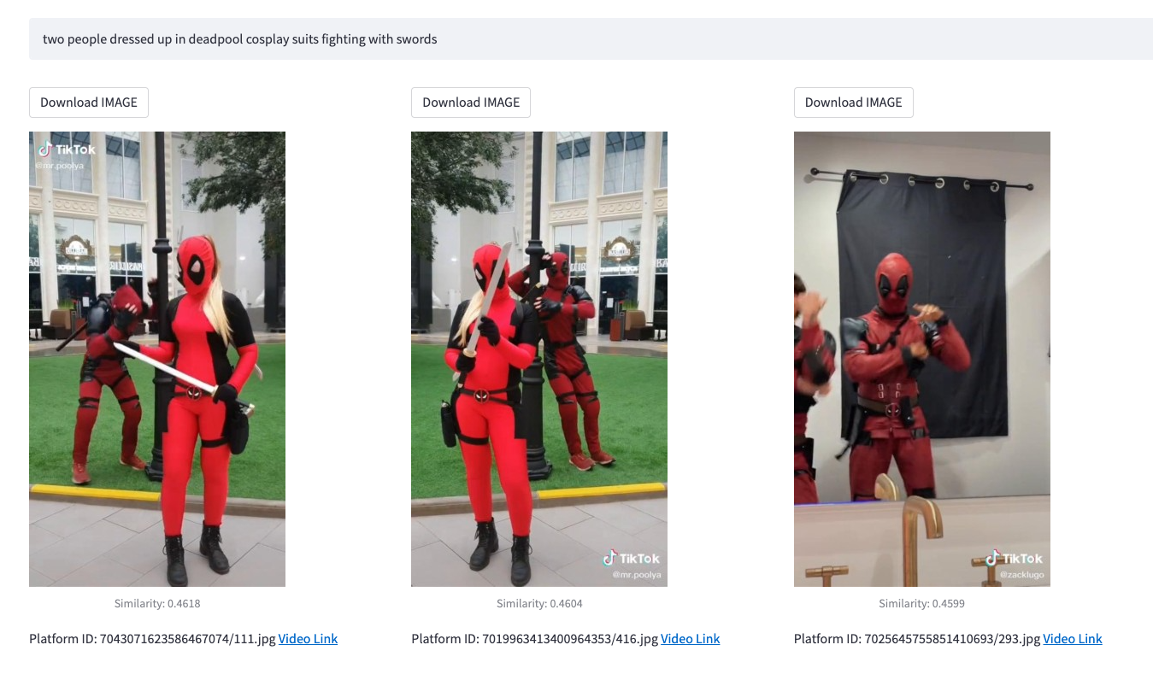
Text search

Slide 9
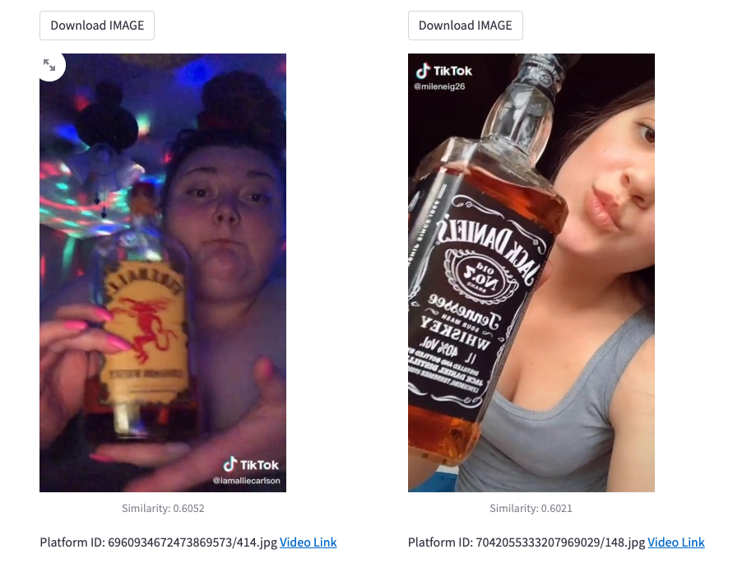
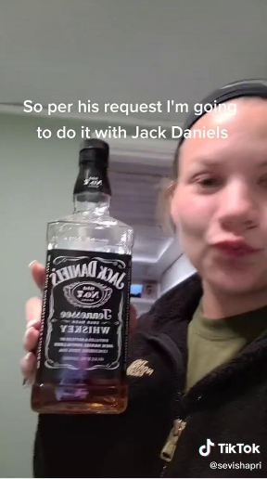
Image search

Slide 10
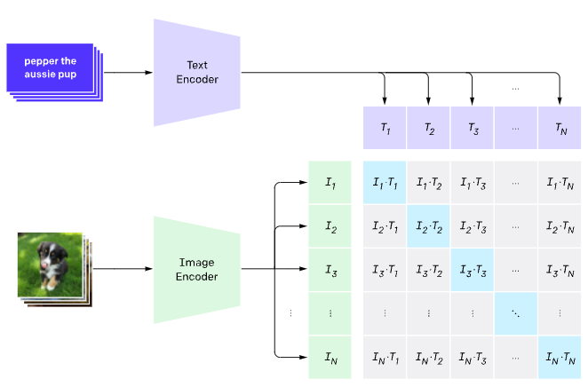
OpenAI’s CLIP for extracting embeddings
Pre-trained on 400M Image-Text pairs with Contrastive loss
Objective:
Minimize distance between image/text embeddings from the same example, AND
Maximize distance between image/text embeddings from different examples
Modular and relatively light-weight
Multiple variants of CLIP available
Using the LAION-2B L/14 model currently

Slide 11
How to index?
Index embeddings extracted for all frames (TikTok, YouTube, Meta)
Have fast response times (<100ms)
Probably okay to do an approximate search
Top 8 out of 10 best results works, especially as the index size scales
Approximate Nearest Neighbors (ANN) to the rescue

Slide 12
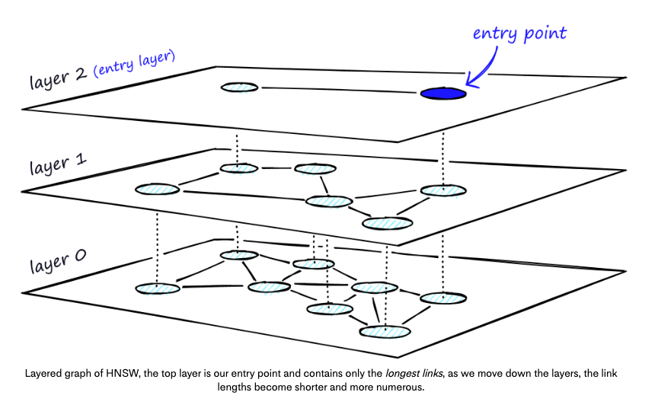
Hierarchical Navigable Small Worlds (HNSW) Graph
Notes:
Construction of the Graph:
The data points (vectors) are inserted into the graph one by one. The first point becomes the initial entry point (root) of the graph.
For each subsequent point, it's connected to a set of existing points in the graph based on their similarity. These connections form the edges of the graph.
Hierarchical Structure:
The graph is organized in multiple layers or levels, forming a hierarchical structure. Each layer contains a subset of points from the previous layer.
The first layer consists of the entire data set. Each subsequent layer contains a smaller subset of points that are selected to maintain the graph's navigability.
Navigable Small World Property:
HNSW maintains the "small world" property, which means that the graph is highly connected, and the distances between points remain relatively short.
The "navigable" aspect refers to the fact that the graph is structured in a way that makes it efficient to navigate from one point to another while preserving locality.
Search Process:
When performing a nearest neighbor search for a query point, the search starts from the initial entry point (root) and proceeds layer by layer.
In each layer, the algorithm identifies a set of candidate points that are likely to be close to the query point.
The search narrows down the candidates and progresses through the layers until a sufficient number of nearest neighbors are found or a stopping criterion is met.
Pruning and Refinement:
During the search, HNSW uses various techniques to prune away unlikely candidates that are far from the query point. This reduces the search space and speeds up the process.
Once a set of candidate points is identified, the algorithm refines the search by considering a smaller neighborhood around each candidate.
Approximate Search:
HNSW is designed for approximate nearest neighbor search, meaning that it may not always find the exact nearest neighbors but aims to provide results that are sufficiently close.

Slide 13
Qdrant
Open-source, scalable and efficient
Allows addition, deletion, querying together at serving time
Optimized for real-time serving
Supports a variant of HNSW; modified to support real-time updates
Allows complex filtering queries with metadata, combining vector search with query conditions
“find images similar to `Image A` which contain the text ‘fyp’ in hashtags and is >30 secs”
Has Custom Ranking function support, to further fine-tune results based on specific requirements
Notes:
Distributed Architecture: Vespa's distributed architecture allows for data to be partitioned and replicated across multiple nodes. HNSW implementations in Vespa can take advantage of this architecture to ensure both data availability and query parallelism.

Slide 14
How is it being used?
Search index
Additional similar rows to incorrect labels
Incorrect
labels
Labelled data
ViT Model
Predictions on validation data
Notes:
Generate high quality labels with good recall from the universe of our data
Find more examples similar to already flagged labels
Things that are similar are likely to be flagged the same
Use embeddings clusters as model features
Generate highly-filtered data for our review queues rather than a random.pick()
Think a bunch of needles in a haystack, if not the needle

Slide 15
Future Goals
Large scale fine tuning of CLIP ViT model
Tiktok/Meta video/caption pairs
Filter the best matching frame to the caption using CLIP Similarity
200M image-caption pairs (growing daily)
Filter additional ones out based on low similarity score.
Plan to scale to >1B vectors very soon
Add additional metadata to enable even more complex filters
Finetune and re-index!
Notes:
Add wink emoji here if possible

Slide 16


